Slide 1

Python Strategy
Leonel Abreu
leonel_abreu

Slide 2



Slide 3

AGENDA
What is story telling?
The starting point.
From theory to practice.
Two scenarios:
Real Estate.
A non popular sport.
The funny fact.

Slide 4
What is story telling?
Notes:
Storytelling is the process of using fact and narrative to communicate something to your audience. Some stories are factual, and some are embellished or improvised in order to better explain the core message.
The bad graphics.

Slide 5





What is story telling?
Notes:
Storytelling is the process of using fact and narrative to communicate something to your audience. Some stories are factual, and some are embellished or improvised in order to better explain the core message.
https://goalstoresults.com/different-stages-of-data/

Slide 6
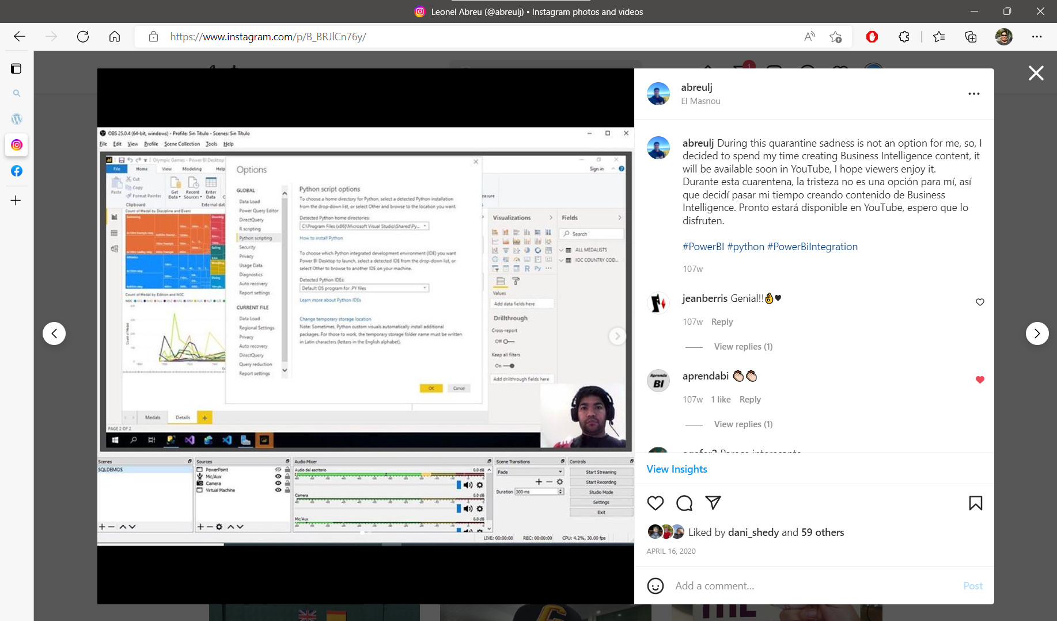
Notes:
Storytelling is the process of using fact and narrative to communicate something to your audience. Some stories are factual, and some are embellished or improvised in order to better explain the core message.
https://goalstoresults.com/different-stages-of-data/

Slide 7

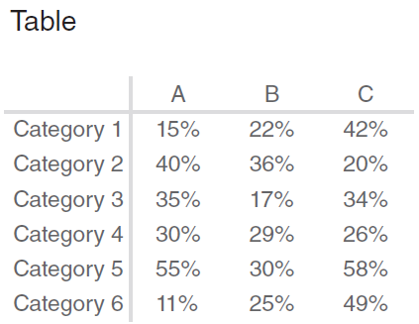
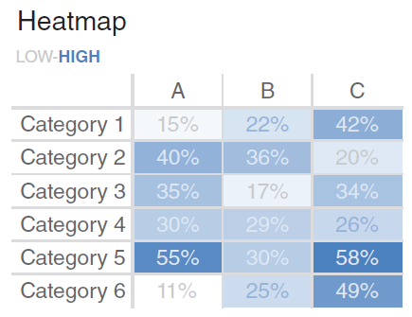
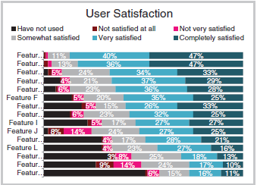
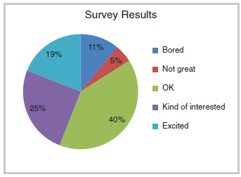
From theory to practice
Short Tips
Avoid the bad graphs.
Focus on our interest.
Leave the calcs in the backend.
Keep it Simple
→

Slide 8















I don’t have the absolute truth
Data Sources
Staging Area
Final Model
UI
Cloud
Data Science
Reports
ETL
Spreadsheets
Apps
Dashboards
Users
DATA
MART
WAREHOUSE
Social feeds
Exact copy of the source
KPI’s
¿Cubes?

Slide 9
Two scenarios

Slide 10
Real Estate Predictions
How useful is the Idealista API?
Notes:
Linear regression is an algorithm used to predict, or visualize, a relationship between two different features/variables. In linear regression tasks, there are two kinds of variables being examined: the dependent variable and the independent variable.
In easy words a model in statistics which helps us predicts the future based upon past relationship of variables. So when you see your scatter plot being having data points placed linearly you know regression can help you!

Slide 11
demo

Slide 12
The sport usage
Let’s do a short introduction about baseball.

Slide 13
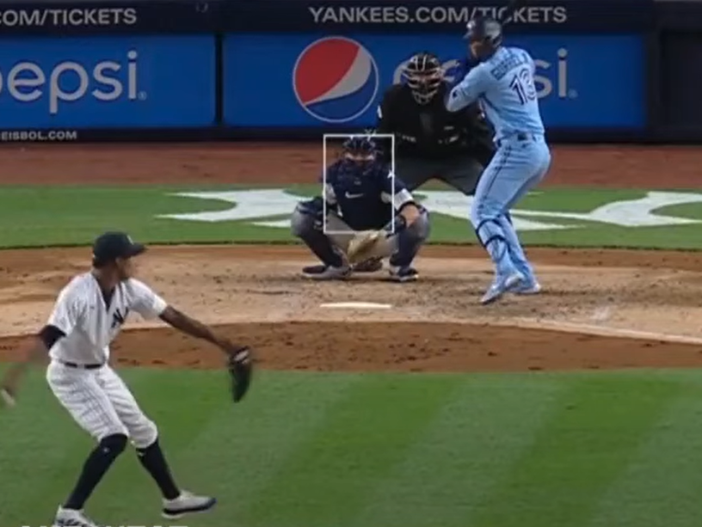
Notes:
Fastball and breaking balls.

Slide 14
demo

Slide 15
The funny fact

Slide 16
Q & A

Slide 17
Dziękuje bardzo za uwagę

